Slide 1
Getting Ready Exercise
Prof. Freddy Gabbay and Alex Grinshpun

Slide 2
Outline
Memory mapped accelerators
Vivado Block Level Simulation
Accelerator FPGA Running (Full chip)
Vivado debugging with iLA

Slide 3
1. Memory Mapped Accelerator

Slide 4
Memory Mapped Accelerators
A designated hardware add to the microprocessor core that is aimed to do a dedicated compution: e.g., matrix multiplication, FFT etc.
The accelerator is mapped to the memory space of the core through a dedicated address range
The core and the swoftware can communication with accelerator by reading or writing these special addresses

Slide 5
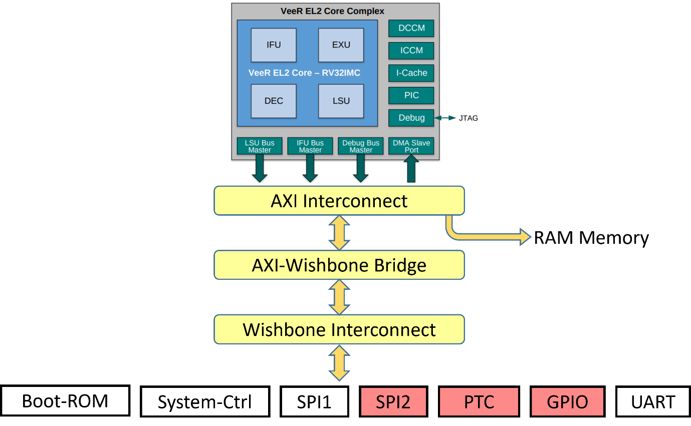

Memory Mapped Devices and Accelerators in RVfpgaEL2 core
Address space
System | Address
Boot ROM | 0x80000000 - 0x80000FFF
System Controller | 0x80001000 - 0x8000103F
7-Segment ASCII Enable | 0x80001004
7-Segment ASCII 4 First letters | 0x80001014
7-Segment Enable | 0x80001038
7-Segment ASCII 4 Last letters | 0x8000103C
SPI1 | 0x80001040 - 0x8000107F
SPI2 | 0x80001100 - 0x8000113F
PTC | 0x80001200 - 0x8000123F
Our accelerator accelerator_top.sv | 0x80001300 - 0x800013FF
GPIO | 0x80001400 - 0x8000143F
UART | 0x80002000 - 0x80002FFF
Memory mapped
devices
accelerator_top.sv

Slide 6
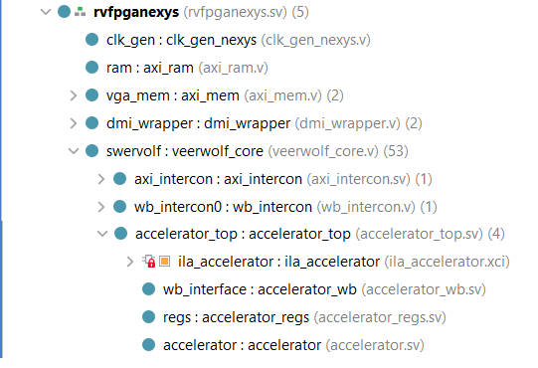
accelerator_top.sv – Block Diagram
Accelerator system verilog is
already integrated into the RISCV core
System On Chip (SoC)
Accelerator Memory Map
Wishbone bus
Signal name | Direction | Type
clk | input | logic
wb_rst_i | input | logic
reg_a | input | logic [31:0]
reg_b | input | logic [31:0]
reg_result | output | logic [31:0]
overflow | output | logic
wb_clk_i
accelerator_wb
wb_rst_i
wb_adr_int[7:0]
wb_data_reg_in[31:0]
wb_data_reg_out[31:0]
re_o
we_o
accelerator_regs
reg_a[31:0]
reg_b[31:0]
reg_result[31:0]
overflow
accelerator

Slide 7
accelerator_wb interface
Signal name | Direction | Type
clk | input | logic
wb_rst_i | input | logic
wb_stb | input | logic
wb_cyc | input | logic
wb_ack | output | logic
wb_sel | input | logic
wb_addr_i | output | logic [31:0]
wb_data_i | output | logic [31:0]
wb_data_o | input | logic [31:0]
wb_addr_reg | output | logic [7:0]
wb_data_reg_in | output | logic [31:0]
wb_data_reg_out | output | logic [31:0]
we_o | output | logic
re_o | output | logc

Slide 8
accelerator_regs interface
Signal name | Direction | Type
clk | input | logic
wb_rst_i | input | logic
wb_addr_i | input | logic [31:0]
wb_data_i | input | logic [31:0]
wb_data_o | output | logic [31:0]
wb_we_i | input | logic
wb_re_i | output | logic
reg_a | output | logic [31:0]
reg_b | output | logic [31:0]
reg_result | input | logic [31:0]
overflow | input | logic

Slide 9
Accelerator Design Details
The accelerator performs a vector addition as follows:
  REG_RESULT[0]=REG_A[0]+REG_B[0]
  REG_RESULT[1]=REG_A[1]+REG_B[1]
Design details:
  Calculates SUM of 2 8-bit signed values
  accelerator_top.sv module in SystemVerilog is mapped to memory space: 0x80001300 - 0x800013FF
  Frequency 12.5 MHz
  REG_RESULT is a read only register
  Status register has 1-bit for an overflow indication

Slide 10
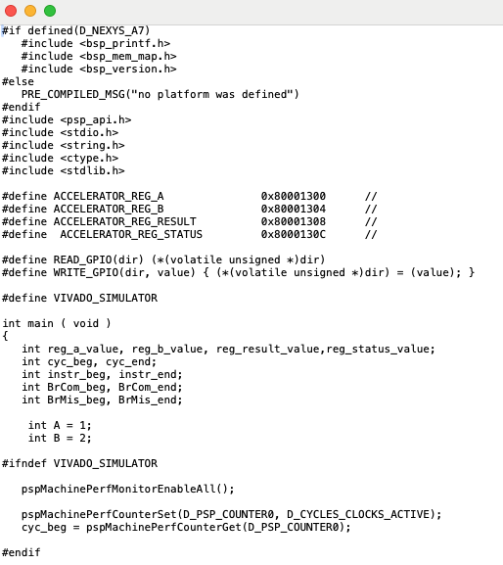
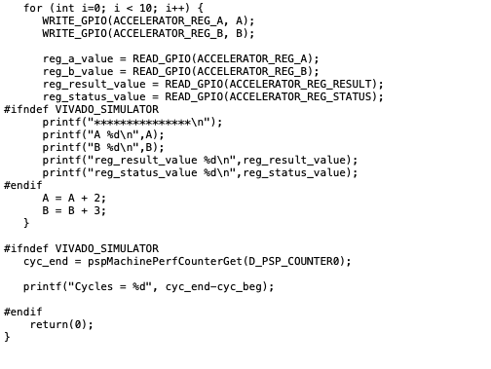
C Program
Accesses to accelertor
memory space
Build program in SEGGER ES
Accelerator addresses
Comment
when
running
on FPGA

Slide 11
2. Vivado Block Level Simulation

Slide 12
Vivado Environment
Editing SystemVerilog code
Compilation (Synthesis, place-and-route, timing) of SystemVerilog code
Running and debugging SystemVerilog simulation
Generating bitstream and programing the SystemVerilog code into the FPGA board
Debugging the SystemVerilog implementation on the FPGA board

Slide 13
Simulation versus Running on FPGA
Simulation
  Slower than FPGA
  Faster compilation – no need for bitstream generation and programming
  Better debuggability than FPGA:
    Can trace many signals
    Can control time (clock) progress
  Fast turn around time
Running on FPGA
  Slow turn around time due to bitstream generation and programming
  Hardware runs much faster than simulation
  Debuggability is more limited
    Limited number of sample clock and signals

Slide 14
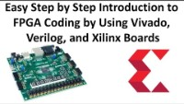

Vivado Basic Training Courses
Vivado user guide – click here

Slide 15
Vivado Block Level Simulation
BLOCK LEVEL SIMULATION IS FASTEST AND SIMPLEST WAY TO DEBUG YOUR SYSTEMEVERILOG CODE
wishbone_accelerator_tb
accelerator_top
wb_interface
regs
accelerator
wb_accelerator_tb.sv
wb_write( address,write_data);
wb_read( address);
A Verilog test example
Example of test sequence: wb_accelerator_tb.sv
initial begin
$display("Test start *****************");
A=1;
B=2;
for (int i=0;i < 10;i++) begin
wb_write(`ACCELERATOR_REG_A , A);
wb_write(`ACCELERATOR_REG_B,B);
wb_read(`ACCELERATOR_REG_RESULT);
A= A+2;
B= B+3;
end
$display("Test complete **************");
Accelerator
Testbench

Slide 16
Vivado Block-Level Simulations
Open Vivado
Open Project
  Project name: accelerator
  Project location: <your_path>/RVfpgaEL2_01/wishbone_simulation/accelerator.xpr

Slide 17
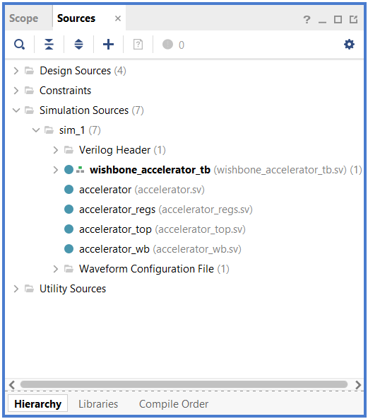
Vivado Block-Level Simulations
In Sources: Hierarchy Window you should now see this

Slide 18
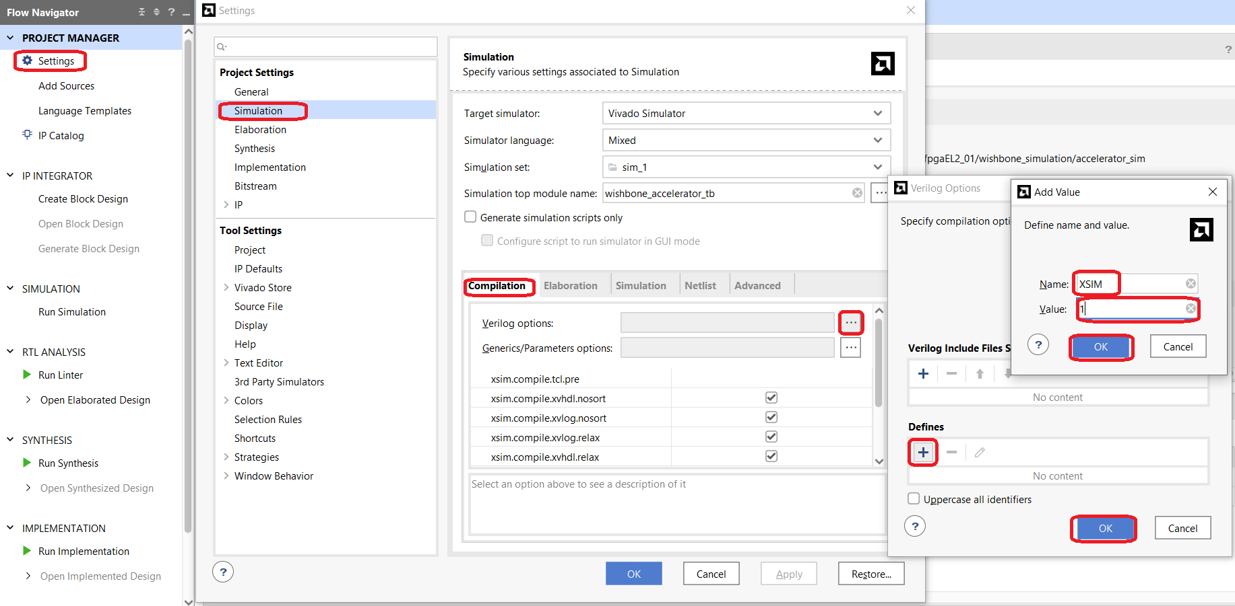
Vivado Block-Level Simulations
Go to Project Manager-> Click Settings-> Select Simulation->Click Verilog Options
Define XSIM 1
Click O.K several times

Slide 19
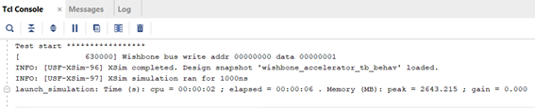
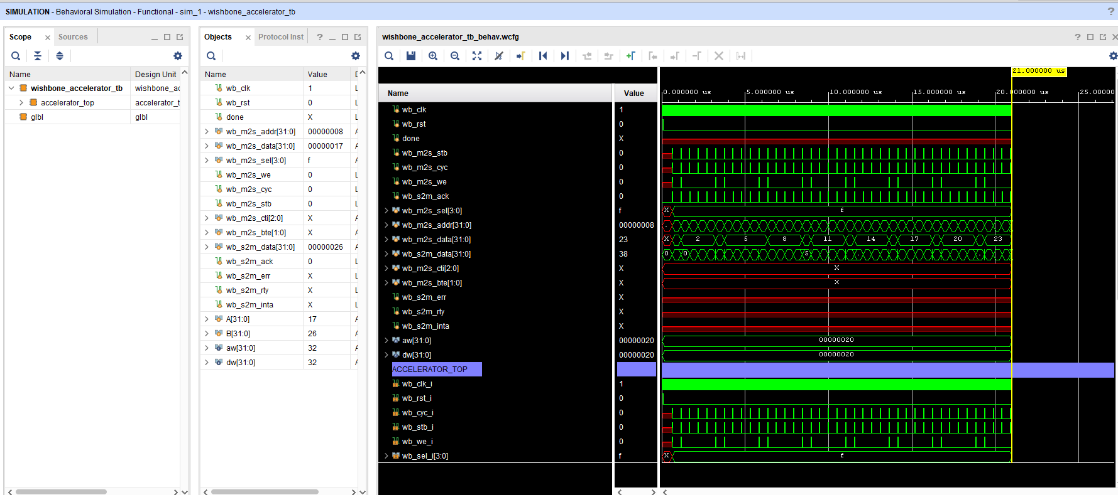
Vivado Block-Level Simulations
In Project Manager -> Click Simulation->Run Simulation-> Run Behaivioral Simulation
Check Tcl Console for NO Errors
Click:
Observe waveform

Slide 20
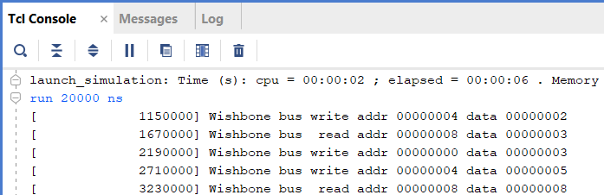
Vivado Block-Level Simulations
Check test execution:
To check errors, go to the log files in: <your_path>/wishbone_simulation/accelerator/accelerator.sim/sim_1/behav/xsim
Look for errors in log files and fix it if needed:
  compile.txt
  elaborate.txt
  simulate.txt

Slide 21
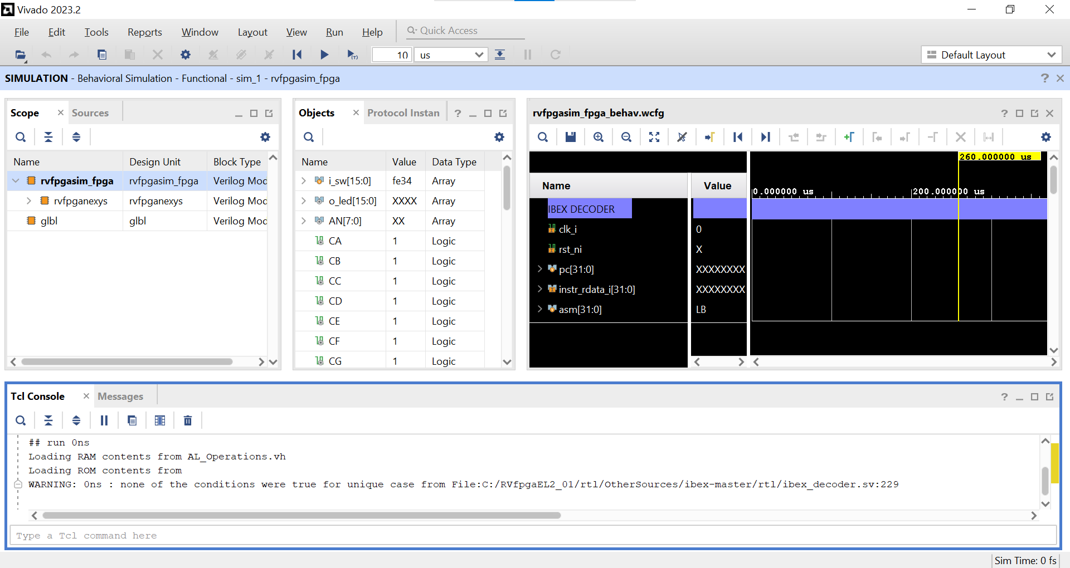
Restart simulation
Run simulation
Run for 10usec
Simulation waveform
Signals in hierarchy
Source files
Drag signal to waveform
window
Assembly instruction text decode

Slide 22
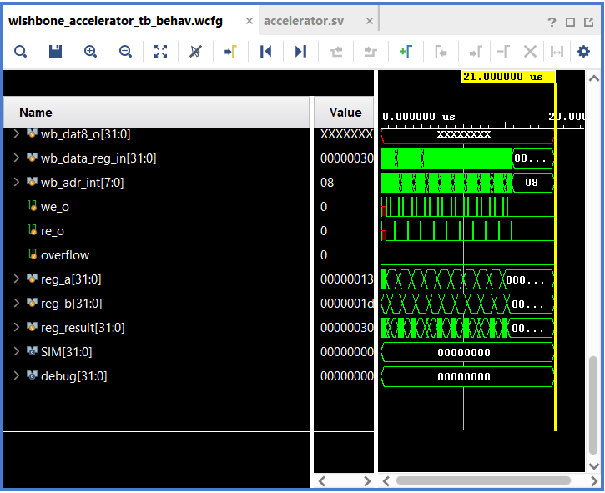
Accelerator Related Signals

Slide 23
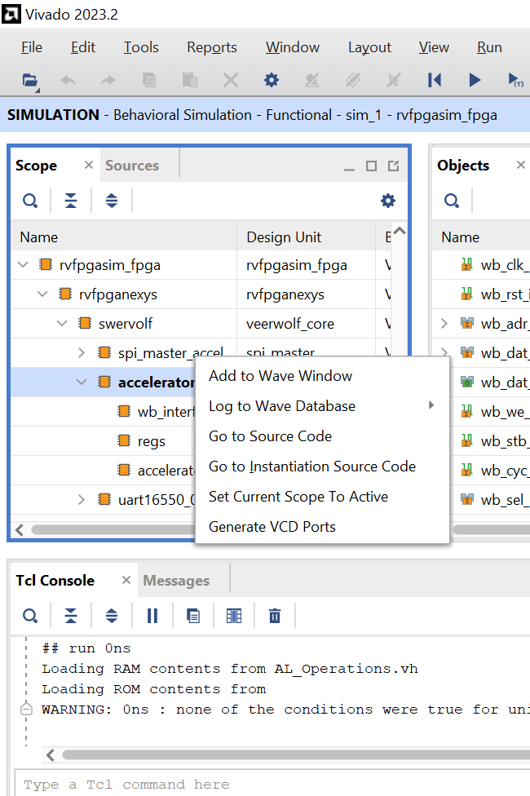
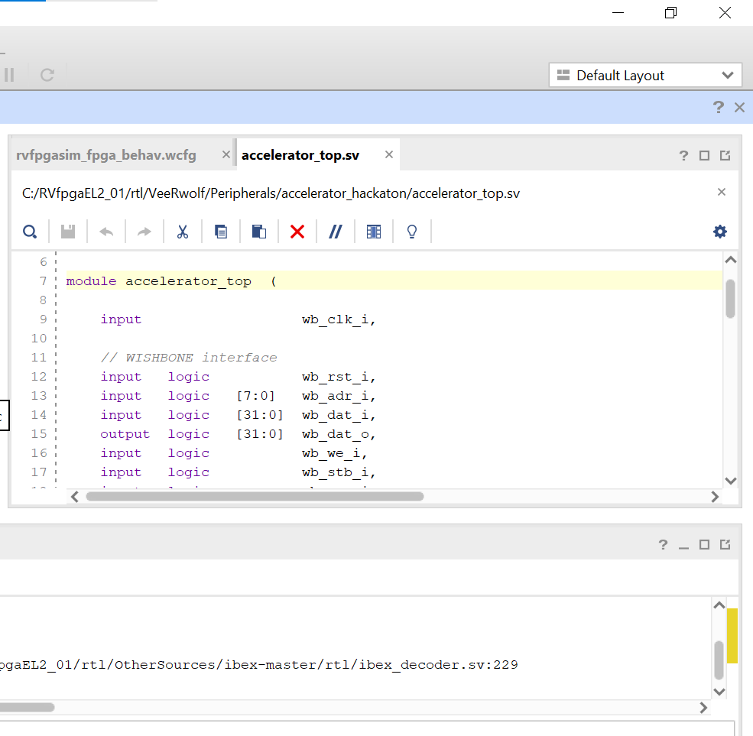
Right click
for opening
source code

Slide 24
3. Accelerator FPGA Running (Full chip)

Slide 25
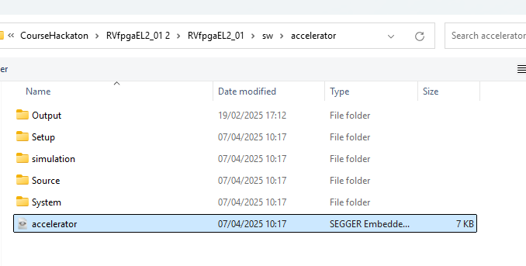
Running Accelerator on FPGA in Full Chip Environment
Similar to preperation exercise number 1, program the RISCV (including the accelerator) into the FPGA
Compile the accelerator C program (slide 10) under:
sw/accelerator/Source
Project file is:
sw/accelerator/accelerator
Run the C program on the RISCV core through SEGGER ES
Check the output results in terminal window

Slide 26
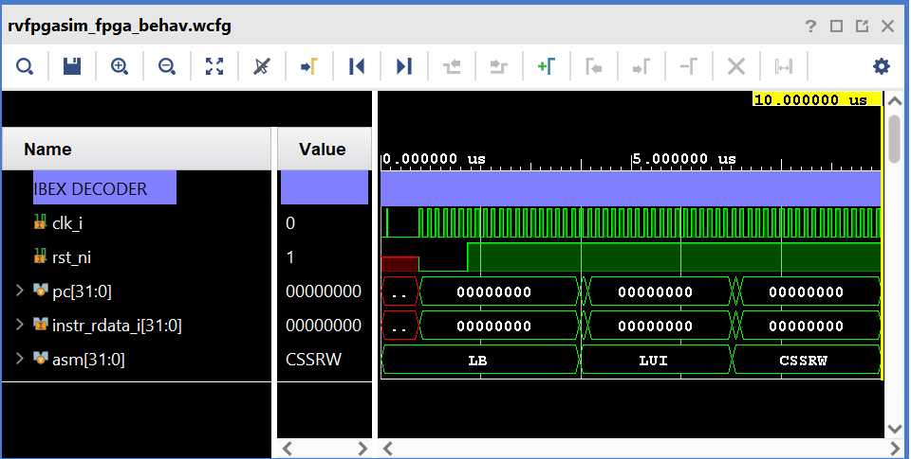
Simulation Waveform
Zoom in/out
More information on Vivado simulation can be found here

Slide 27
4. Vivado Debugging with iLA

Slide 28
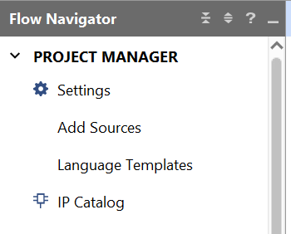
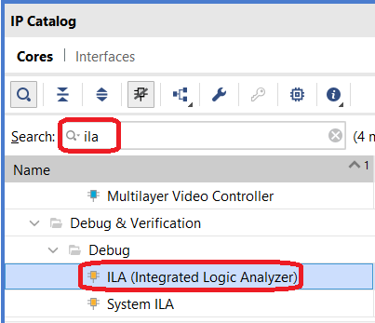
Creating integrated Logic Analyzer (iLA)
1
2
3
Click
Search
Double click

Slide 29
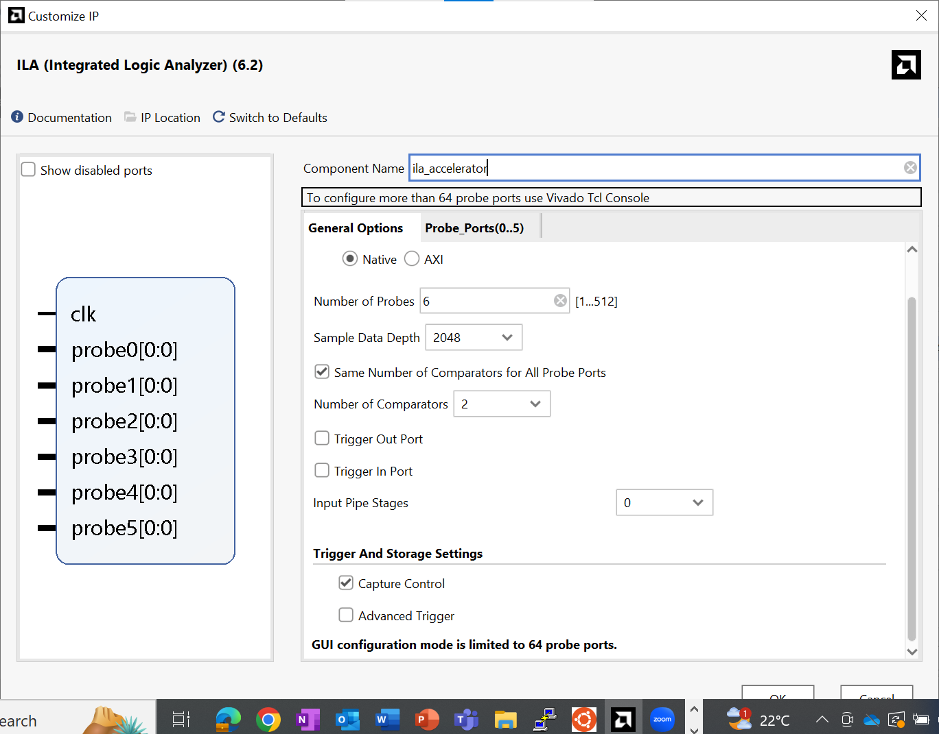
Creating integrated
Logic Analyzer
(iLA)
4
iLA name
5
Specify
Number of signals
Depth size
Capture control

Slide 30
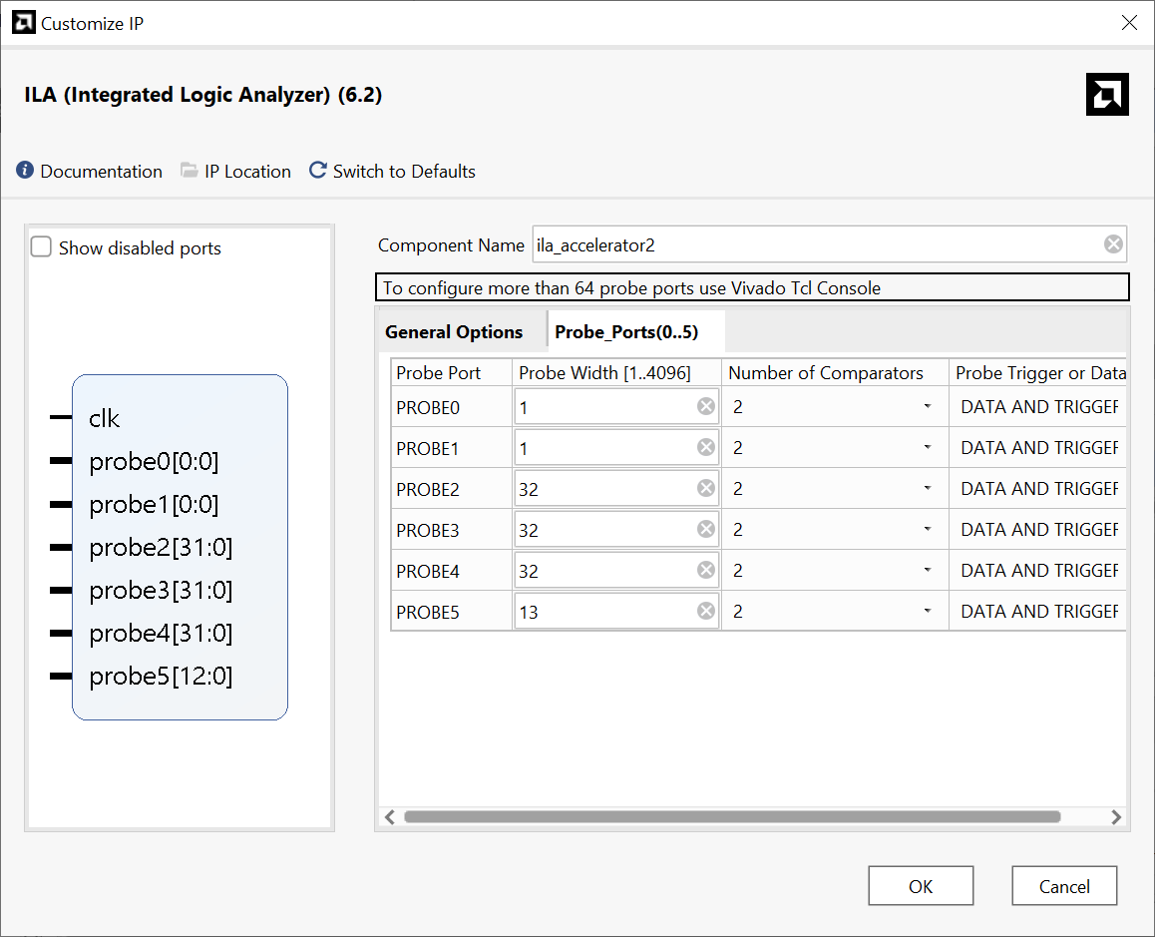
Creating integrated
Logic Analyzer
(iLA)
6
Click here
7
Define probes width
8
Click

Slide 31
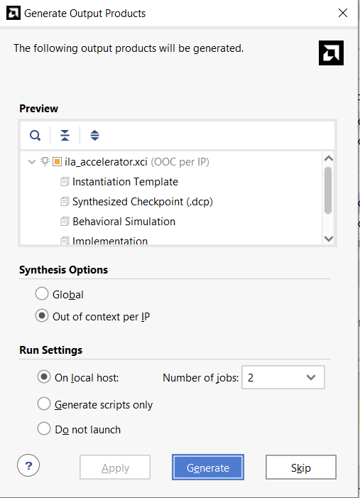
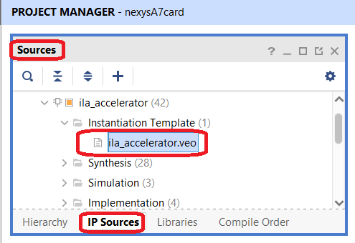
Creating integrated
Logic Analyzer
(iLA)
iLA instance will be added to the sources of the design
9
Click here

Slide 32
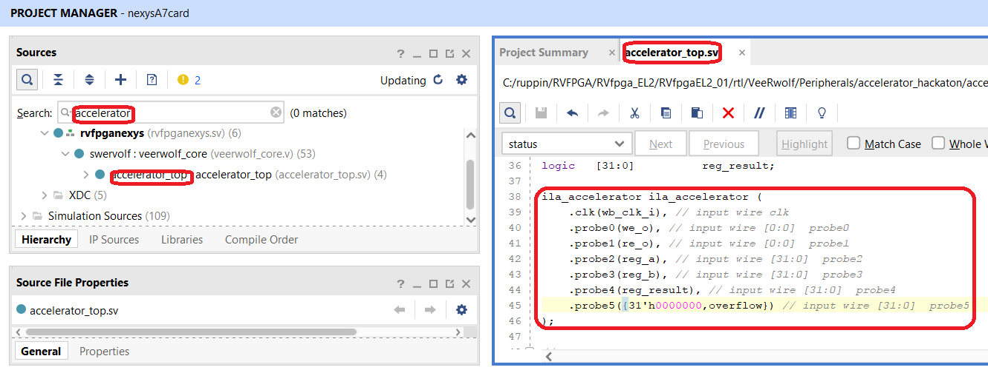

iLA Connection to the Probed Signals
Add an iLA instance and connect the probe ports accordingly
Compile your Verilog files, generate a bit stream and program the FPGA
Pay attention:
Assure the iLA instance name is correct.
Assure that signals correct width
10

Slide 33
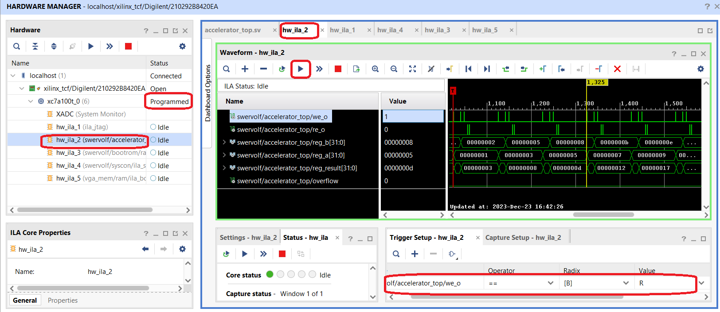
iLA Setting the Trigger
11
Drag with the mouse the signal that will be used as a trigger to the Trigger Setup Window

Slide 34
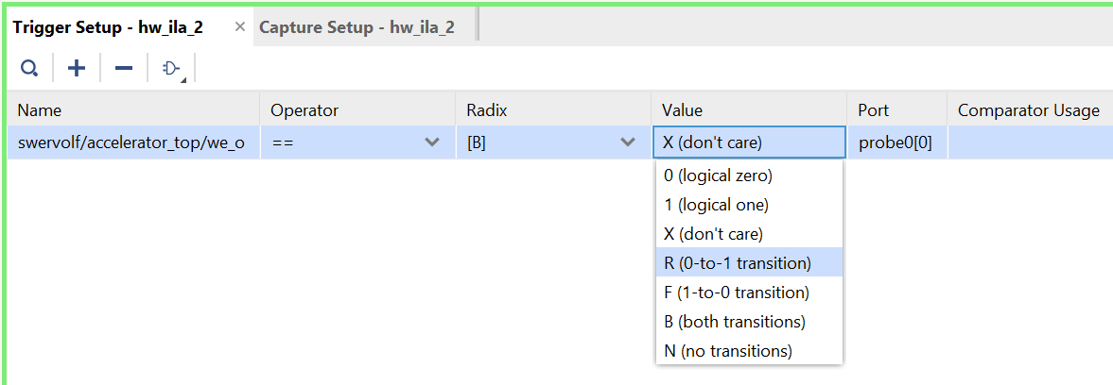
iLA Setting the Trigger
12
Select the value of trigger event

Slide 35
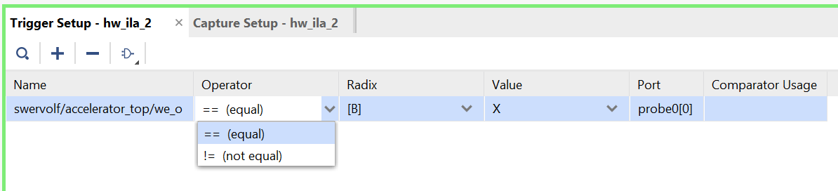
iLA Setting the Trigger
13
Select the operator

Slide 36
iLA Activate the Trigger
Now the iLA interface is waiting for the event to happen
14
Activate the trigger

Slide 37
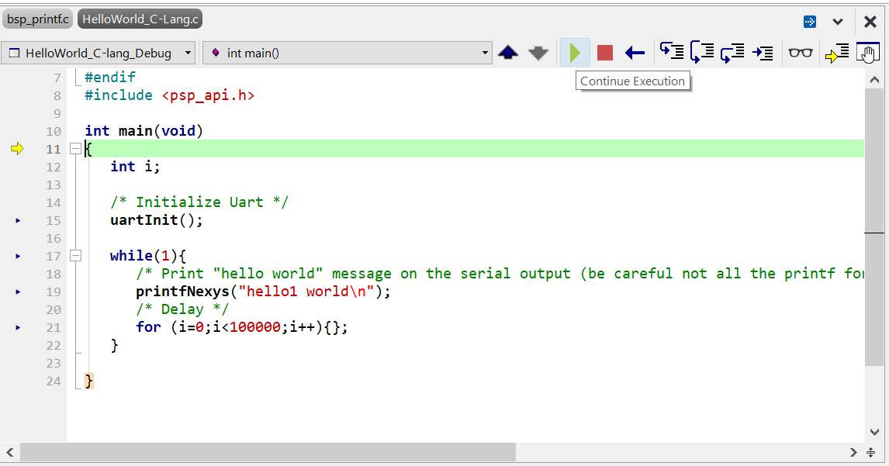
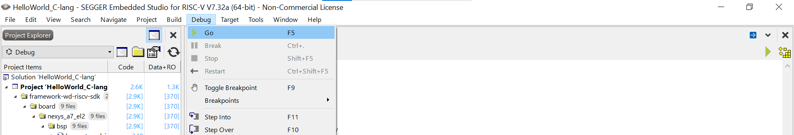
Running SEGGER ES with iLA
15
Run the program on SEGGESR ES studio in order to cause the trigger to happen

Slide 38
Waveform Generated Upon Trigger
Trigger Event

